Slide 1
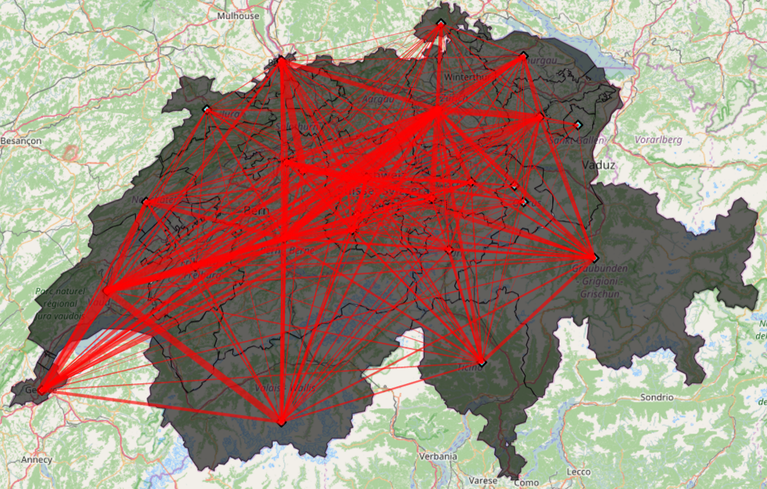
On the move for a good time!
Mobility patterns/events in Switzerland with Twitter
Team
Eric Bezzam (@ebezzam)
Shiyue Nie (@nnnsyyy)
Weiyu Zhang (@BeforeRain)

Slide 2
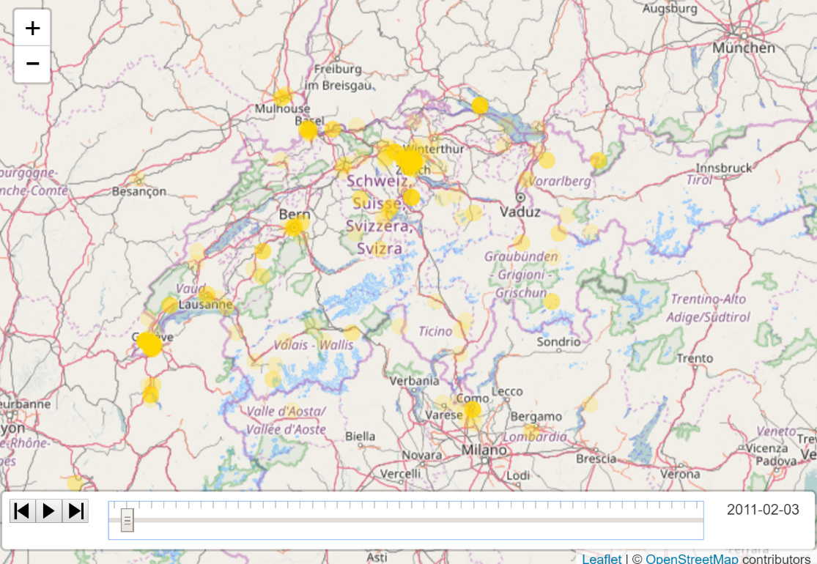
Contents
Data Pre-processing
Inner Movement Extraction (Switzerland)
- Model Framework
- Result
Event Detection
- Tweets Visualization
- Expected Result of Event Detection

Slide 3
Data Pre-processing
Data cleaning (filter, format, extract needed fields)
Geo-locating (Geocoder)
Time separation
Data split store/execution (500+)

Slide 4
Inner Movement Extraction (Switzerland)
Aim
- Most popular canton/routine
Model
- Individual: Space-time trajectory [1]
- Visualization: polyline-network in canton level

Slide 5
Model Framework
Data-preprocessing:
- Extract geo-location and time (year, month, day etc.)
Space-time Twitter user trajectories:
- Tuple <userId, loc (latitude and longitude), time>
- Filter valid movement (in reasonable speed)
Trace extraction:
- Figure out (daily) trace of each user
- Select (daily) trip (no inner-city trip)
Visualization with weighted polyline

Slide 6
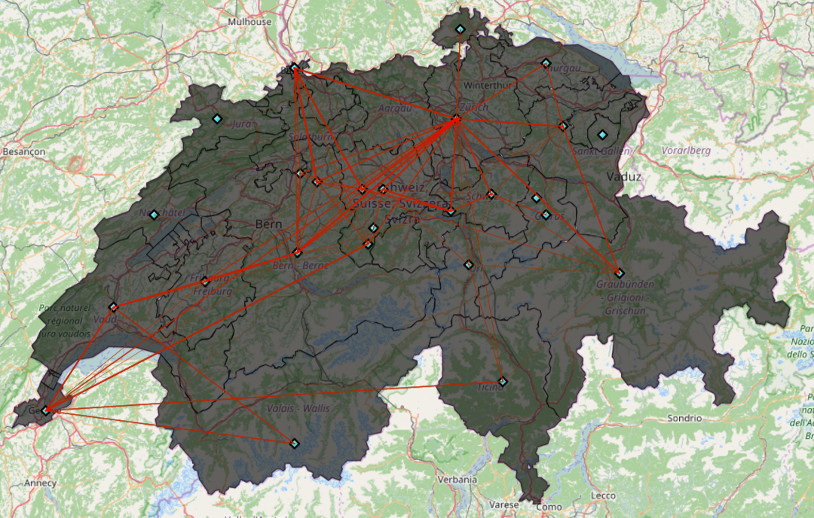
Result
All ‘daily’ traces: accumulate all trips in one day
Map 1: Partial data (1/500)
Map 2: All data (Over 10 trips)

Slide 7
Result
All ‘daily’ traces: accumulate all trips in one day
Map 1: Partial data (1/500)
Map 2: All data (Over 10 trips)

Slide 8
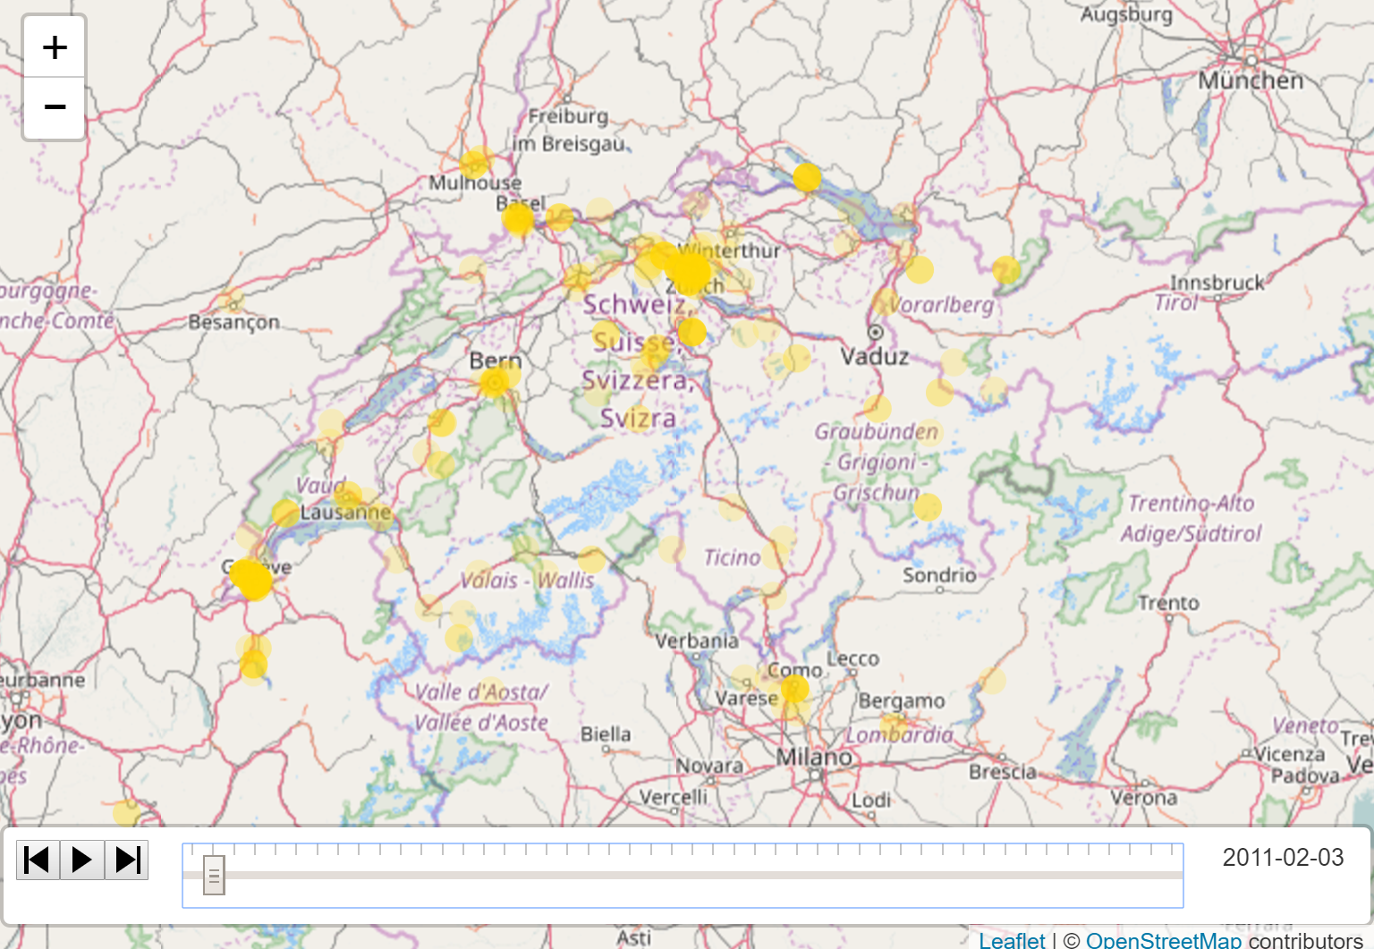
Tweets Visualization

Slide 9
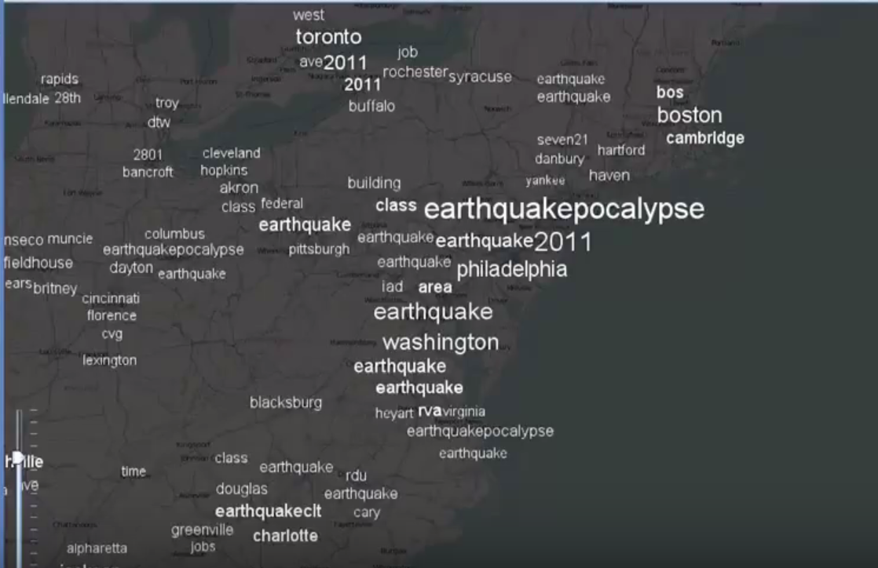
Expected Result for Event Detection
Event Detection
-- expected result [2]

Slide 10
Thanks
Reference
[1] Exploring Multi-Scale Spatiotemporal Twitter User Mobility Patterns with a Visual-Analytics Approach [2] Spatiotemporal Anomaly Detection through Visual Analysis of Geolocated Twitter Messages

